Slide 1
CDS Evaluation
Module —Heuristic Evaluation
Notes:
Instructor and learner introductions

Slide 2
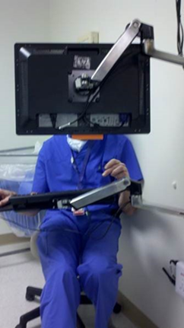
module 5 Objectives
By the end of this module, you will be able to:
Identify criteria for using a heuristic evaluation
Use provided material to conduct an assessment
Demonstrate the four steps to compile and analyze data
Discuss one common format to report data

Slide 3
Module 5 Overview
Introduction to heuristic evaluation
Heuristic categories with examples
Apply CDS Impact Evaluation Framework steps to heuristic evaluation
Analyze data from a heuristic evaluation
Assign heuristic categories and severity ratings for usability issues identified on the VA’s BCMA screen
Usability resources
Notes:
Here are the topics this module will cover.

Slide 4



Why Do Designs Need Heuristic Evaluations?
Theresa Brown (2015), The Shift, p. 117
Staggers, N. & Makar, E. (2016).
Identifying Solutions to Nurses Health IT Pain Points.
HIMSS 16. Las Vegas, NV. March 1, 2016
Notes:
Theresa Brown wrote a book called The Shift while she worked on a hem-onc unit. She briefly wrote about her experience with the local EHR. You may hear her read this passage by clicking on the audio icon (your technology permitting). Here is what she wrote:
I do understand why thoroughness in documentation matters legally, but I sometimes wonder if sadists designed our software. It should not be easier to order a sweater from Lands End than to chart on my patients, but it is. Click, scroll, type, enter. Here's the menu with twenty choices, none of them the one I need. Here's the point where I need information from two different screens, but there's no way to toggle between them. Here's the screen with thirty discrete options to check, but the window it opens up only shows me five at a time. New lab results, X-rays, CT scans, MRIs: none of those generate an alert and the screen is full of minute icons, some of which represent functions I don't use or even understand.”
Move to Intro to CDS Eval

Slide 5

Introduction to Heuristic Evaluation
What is heuristic evaluation?
A heuristic is a “rule of thumb”
A classic expert usability method (one of many)
Often employed to assess health IT (or mHealth) applications
Developed > 20 years ago (Nielsen, 1992, 1993)
A “discount” usability method
Online resource: Nielsen Norman Group
https://www.nngroup.com/topic/heuristic-evaluation/
Notes:
There was a brief introduction to this technique in previous modules but we will be going to more depth in this module.
This is a tried and true (classic) method that has been used widely for years. It was developed by Nielsen, the man shown in the bottom right corner of this slide.
Although it’s called an expert method, evaluators who learn the method are considered experts
The technique has been used to assess health applications in the past.
Both Nielsen and Norman (the listed reference on the slide) have been in the HCI/usability/human factors field for years.
Heuristic evaluation is called a discount usability technique because it’s easy to learn and implement, and it consumes relatively little time and resources.

Slide 6

Introduction to Heuristic Evaluation
What does heuristic evaluation do?
Identifies usability problems
Assigns problems to a category
Rates each problem on severity
Can be used to translate usability problems into design requirements
Notes:
In the last module, we covered user observations. In this one, heuristic evaluations. You can use both in an evaluation as that could give you a nice blend of user techniques and expert techniques to discover usability problems.
Evaluators use heuristic evaluation to identify usability problems, assign them to categories (heuristic categories) and then rate their severity. The technique is important as usability problems can then be translated into design requirements. Please note that a usability problem can be assigned to more than one category.

Slide 7

Introduction to Heuristic Evaluation
When to use this method
Anytime in the systems life cycle
Resource considerations
3–5 single-domain experts (e.g., a clinician or a usability expert); OR
2–3 dual-domain experts (trained in usability plus a discipline related to the application)
Notes:
Heuristic evaluation can be used in any phase of the systems lifecycle. Resources are economical: 3-5 (single-domain) and 2-3 (dual domain). An important note is that If evaluators use heuristic evaluation to find usability problems while a product is in development or while tailoring a new product, evaluators can find usability problems early on when they are more easily addressed.
.

Slide 8
Introduction to Heuristic Evaluation
Benefits
Disadvantages
Cost effective
Can be completed virtually
Time effective
Identifies many existing usability problems
Excludes end users
Can generate a list of primarily minor usability problems (especially with single-domain experts)
May not provide guidance on how to remedy identified issues
Concentrates on usability problems versus helpful features
Notes:
This slide summarizes the benefits and disadvantages of Heuristic Evaluation. Its benefits include that it is cost and time effective and typically uncovers many usability problems. Its main disadvantage is that it excludes end users (by definition) and if only single-domain evaluators are not experts in the field the CDS intervention addresses, the list of usability problems may be more minor in nature.

Slide 9
Heuristic Categories with Examples
Notes:
The following slides address 14 heuristic categories from Zhang, et al. (2003). Each is explained and examples are given.

Slide 10
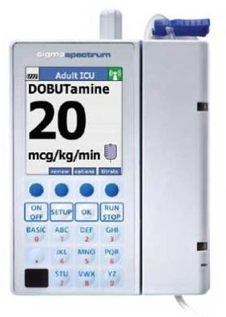
Heuristic Categories
We recommend the 14 categories from Zhang et al. (2003)
Why?
Combines classic work from Shneiderman’s 8 “golden rules,” Nielsen’s 10 categories
Applied successfully to health IT applications
Initially IV pump evaluations
Notes:
We recommend using the 14 heuristic categories defined by Zhang et al. (2003) because they have been used in healthcare and combine previous lists defined by others (Nielsen and Shneiderman specifically).

Slide 11
Heuristic Categories
Heuristic Category | Definition
Consistency and Standards | Product is consistent across all aspects: methods of navigation; messages and actions; and meaning of buttons, terms, and icons. Advanced evaluation: Product is congruent with known screen design principles. Product is consistent with International Organization for Standardization (ISO) usability guidelines (e.g., ISO 9241-11).
Examples
Headings on each screen are the same
Icons are intuitive
Notes:
The first category is consistency and standards. Evaluators look across the CDS intervention for consistency in all aspects. Advanced evaluations can assess whether the product is congruent with screen design principles such as those published by Galiltz. A style guide used during development can help assure consistency in navigation, buttons, icons, etc. ISO 9241-11 is the main standard regarding usability. Evaluators may assess, for example, whether icons are intuitive to health professionals and whether the patient’s name is in the same location on every screen.

Slide 12
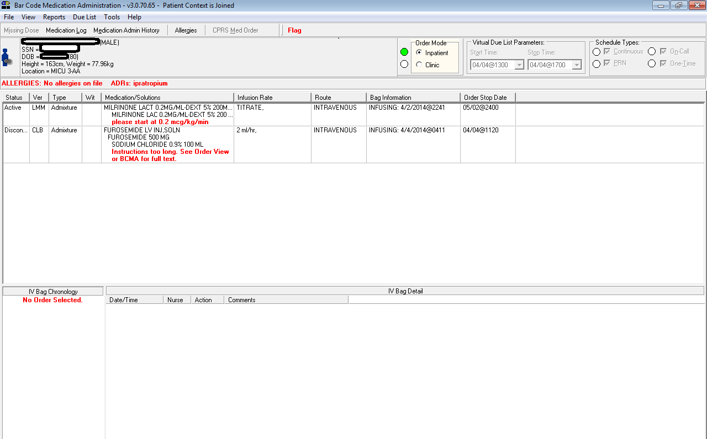
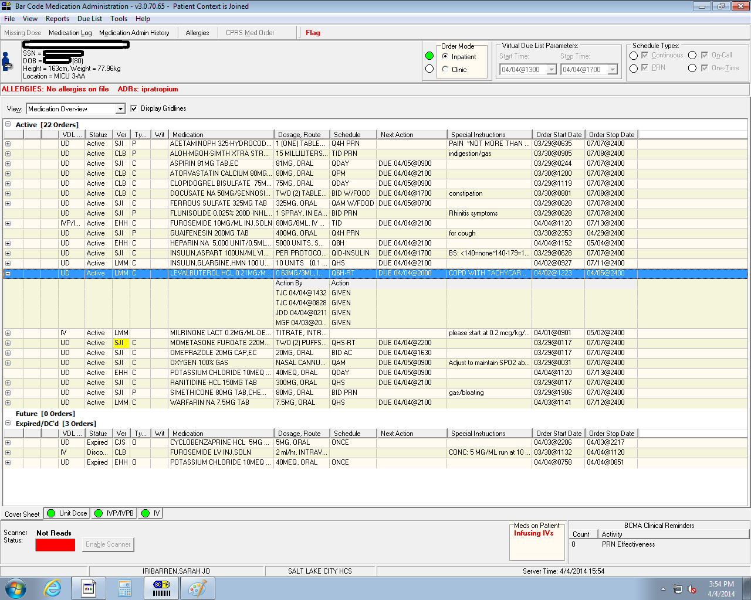
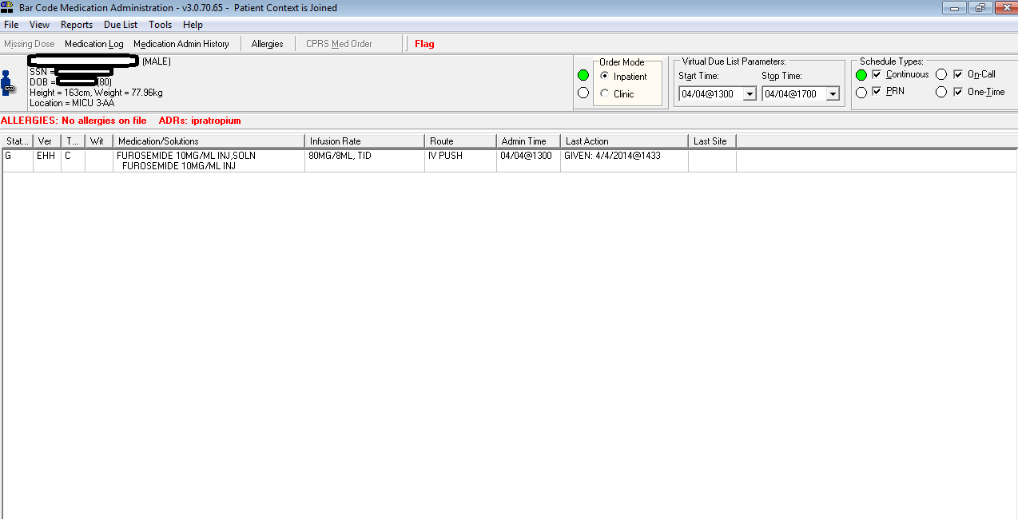
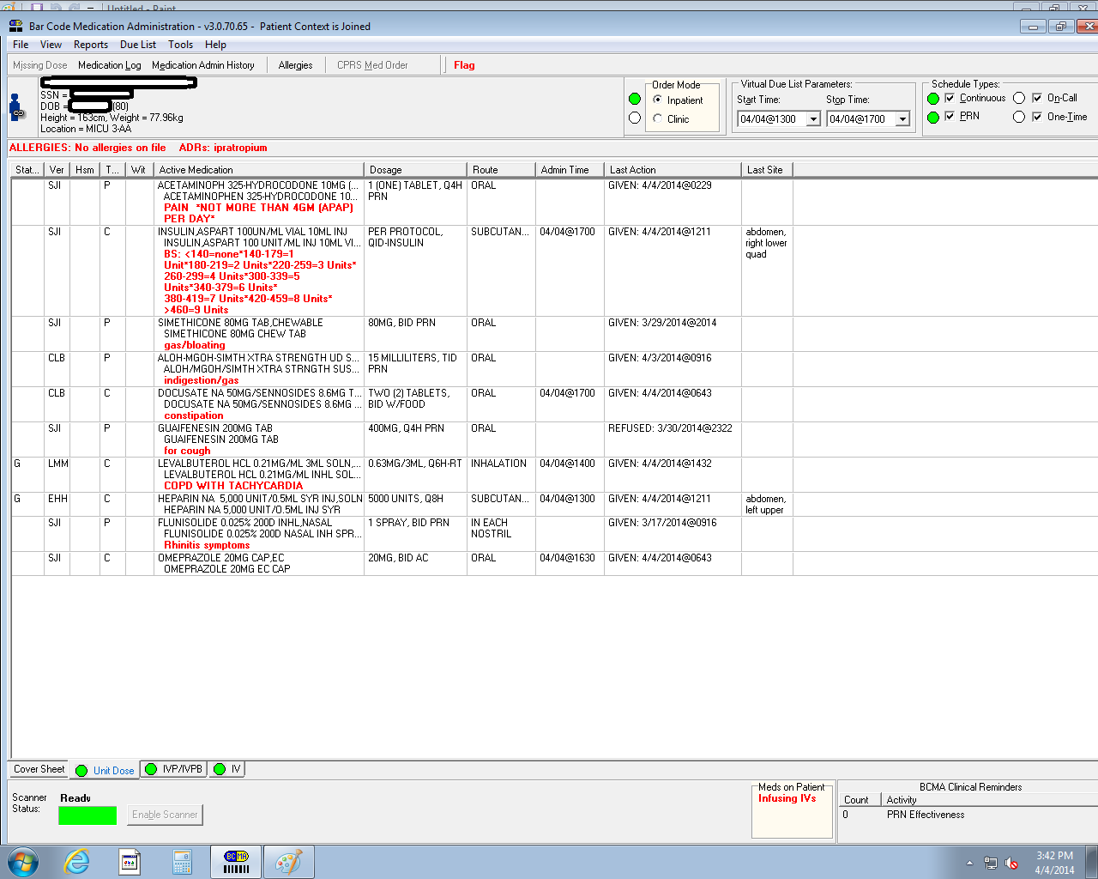
Consistency: Med Administration in the VA
Notes:
These are screens used during medication administration in the VA. The screen with beige highlights is CPRS which has the patient orders. Three other screens are needed for medication administration: one for PO meds, another for IV piggyback and pushes, and one that lists IVs. Consistency is displayed because the heading on the upper left of the screen is the same across all 4 screens. The three medication screens also are consistent in the columns and headers. We will look at some issues with these screens later, but they do offer an example of consistency.

Slide 13
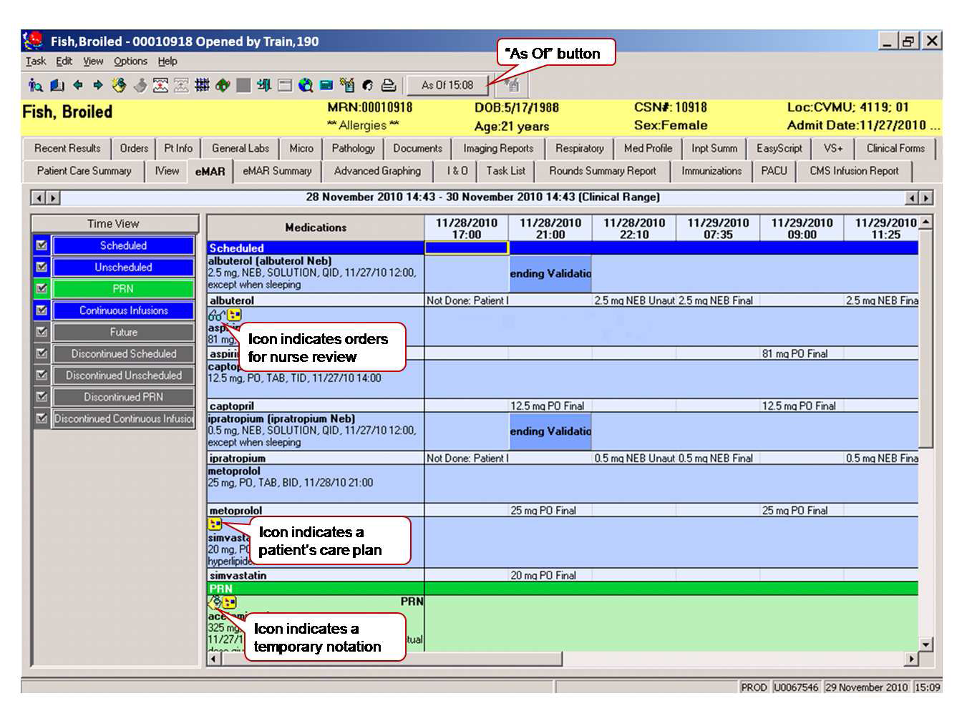
Notes:
This is an example of an electronic medication administration record (eMAR). Medications are listed in a column on the left side of the screen and administration times are listed in associated rows. The tabs on the left provide access to various view of the entire list of medications such as scheduled meds, PRN meds, discontinued ones, etc.

Slide 14
Notes:
We can examine the icons to determine how intuitive they are to clinical users. The eyeglasses icon under Albuterol meant that orders needed nurse review, which makes some sense and is fairly intuitive. However, under Metoprolol, the icon of a yellow square with red and blue spots indicates a link to the patient care plan which isn’t as intuitive and just has to be memorized.

Slide 15
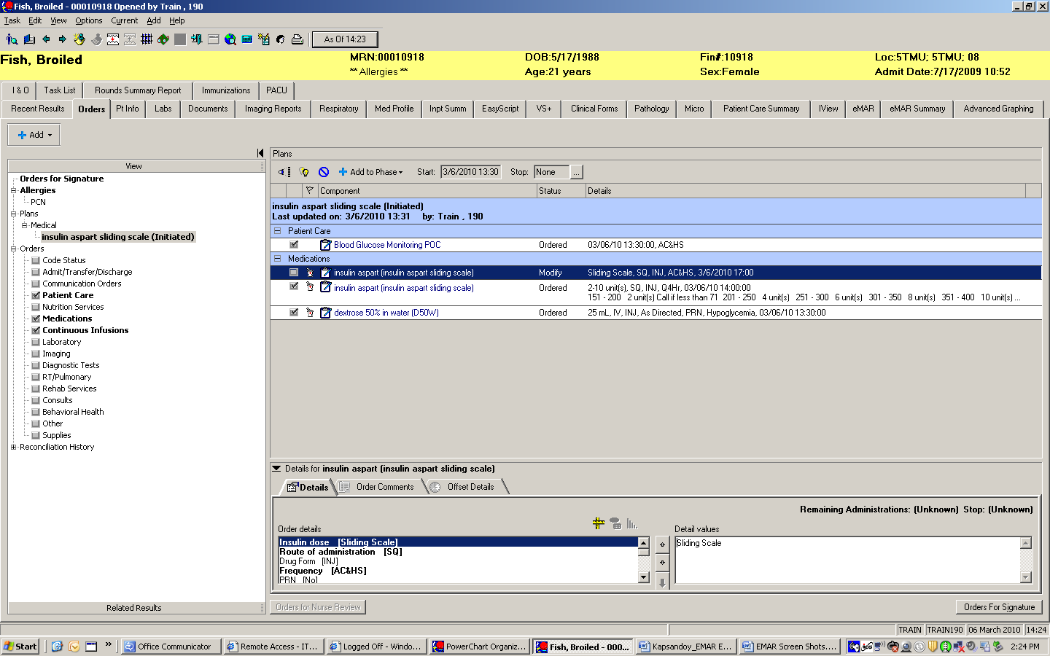
Users must click this icon to retrieve insulin sliding scale data.
Notes:
This slide illustrates a combination visibility and consistency issues for icons. This slide depicts a screen from Cerner. It shows insulin orders (in small font) above and “details” below. When viewing this insulin order, users have to click a symbol that looks like a hashtag to access the insulin sliding scale. That certainly isn’t intuitive.

Slide 16
Heuristic Categories
Heuristic Category | Definition
Visibility of the System State | Users understand what the system is doing and what they can do with the product from the system messages, information, and displays.
Examples
Total wait times should be clear (versus multiple bars or an hourglass with no clear end)
Users should not have to ask “What is the system doing?”
Notes:
A second heuristic category deals with visibility of the system state. An example in the VA is an early VA system that displayed wait times using dots. One dot at a time would fill up the screen. Then, a second screen might appear!
Another example of visibility is a clear indicator that the ordering process is completed. Users should not have to ask: Did the system file my new order or is it still working? People should know what the system is doing…

Slide 17
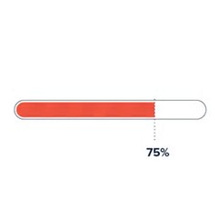
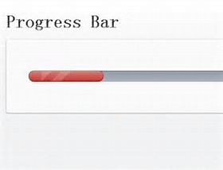
Visibility of the system state
Not clear
Clear
Notes:
On this slide we have both bad and good examples of visibility of the system state using two different kinds of progress bars. We’ve all been on screens where the first progress bar fills up, users think they’re done waiting and then a second progress bar appears. The bar on the left is indicating that the system is doing something but does not show an end-point. What if another bar appears after that first one? The second example on the right gives an indication of when the whole process will be complete (that it is 75% completed now.)

Slide 18
Heuristic Categories
Heuristic Category | Definition
Match Between System and World | The technology matches the way users think and work, uses appropriate information flow, has typical options that users need, and includes expected actions by the system.
One of the most frequently violated heuristics
Examples
The “as of” button on the eMAR (on the next slide)
Fit (or not) to workflow or “thoughtflow”, e.g., congruence between the navigation and the way a clinician thinks
The need for synthesized information, patterns
Vital signs, sign-out or shift report, anesthesia displays
Notes:
The third category is match between the system and the world (or the “real world.”) This is one of the most frequently violated heuristic categories. Health IT products may violate this one if their design doesn’t match the way users think and work, for example. Another example is that HIT may have large volumes of data and information but few options to see synthesized information or to detect patterns in the data.

Slide 19
Notes:
This is the eMAR we saw earlier. Focus on the “as of” button at the top of the screen. This button indicates the last time data were downloaded to the screen. To get the most current data downloads, users must push the “as of” button continuously (because the system only downloads data about every 15 minutes.) If users forget or they are very busy, the risk is that the newest orders get missed, e.g., a critical medication might be discontinued and the nurse wouldn’t know or a new medication might be ordered that the nurse needs to administer.

Slide 20
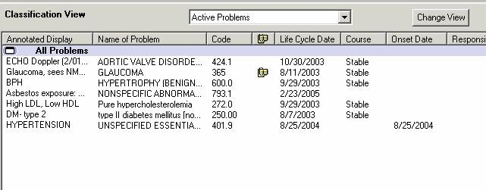
Match with the Real World
Typical Problem List
Notes:
This screen shows a typical patient problem list. This may not match with clinicians’ “real world” because of a few reasons: (1) There is no indication of why a patient is in for the current visit as all problems are listed and no indicators exist for the most recent problems or their urgency), and (2) there is no indicator of the priority of problems. Perhaps hypertension is under control by diabetes is not, for example.

Slide 21
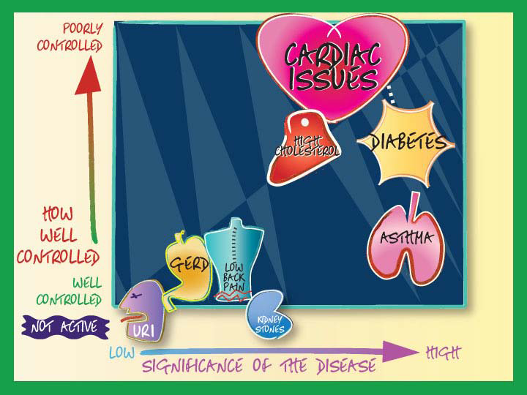
Match with the Real World
Potential Redesign
Berkowitz, 2011
Notes:
This screen depicts a redesign of a patient problem list that illustrates priority problems, the significance of disase and how well controlled conditions are. This example is a bit cartoon-ish, but you can see that the cardiac issues, diabetes, and high cholesterol are the biggest problems by their size and location on the graph. The color helps a clinician determine problem priority, what problems are stable, and each problem’s significance. It’s easy to determine these factors.

Slide 22
Match with the Real World
Staggers, et al., 2012
Notes:
This is a nursing shift report sheet from Cerner. At the time of this research, there were only 2 types of shift reports in the EHR: ICUs and all other units. This report is from a medical-surgical unit. At the top is demographics and vital signs. The whole center section is imported from the patients orders, but a note on the form indicates that the orders are not complete. The bottom shows a hand-written grid for medications and hand-written notes can be seen on the side of the report. Although the sheet listed some information, it did not represent the way nurses work or think about report. In particular, shift report consists of more than information sharing. It is also a time that nurses set care priorities, organize their work for the whole shift including determining specific tasks to be done and write memory jogs for important information such as tracking lab test results on a particular patient. The form helps with some information gathering but does not assist with planning for medications, tasks or priorities.

Slide 23
Heuristic Categories
Heuristic Category | Definition
Minimalist | Product does not display superfluous information. System and screen design are targeted to primary users’ information needs. Use of progressive disclosure to display details of a category of information only when needed. The exception can be designs for expert users where less screen density is preferred.
A balance between screen density versus clutter
Knowing what information clinicians need to make decisions
Notes:
The category called minimalist deals with displaying cogent information to primary users and not displaying superfluous information.

Slide 24
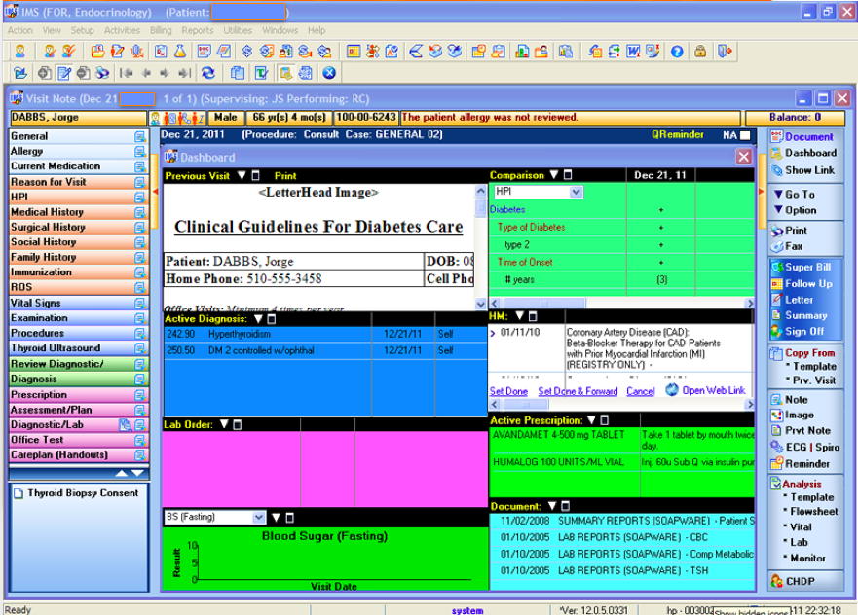
Minimalist
Notes:
This screen might have more than one issue! The designers had the right idea in mind—to consolidate the info needed to assess a patient with diabetes. However, not all the pertinent information is available for a diabetes screening and superfluous information is on the screen. Think of an annual visit for a patient with diabetes and that all pertinent information should be organized for easy viewing such as annual eye and foot exams as well as A1C values. Never mind the distracting colors!

Slide 25
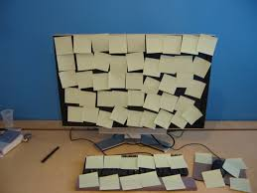
Heuristic Categories
Heuristic Category | Definition
Minimize Memory Load | Product minimizes the amount of information and tasks users must memorize to adequately use the technology. Product makes use of sample formats for data input such as a calendar for date format.
Cues are using shadow systems, writing material on paper (“sticky notes”), having to keep information “in your head”
Examples
Need to memorize steps, sequences, information on screens
Use of memory aids
Notes:
This category was exemplified earlier in the slides where we mention that users had to memorize the meaning of icons, for example. An especially acute problem is having to remember steps and sequences across multiple modules and tasks.

Slide 26
Minimize memory load
Notes:
Back to the BCMA example to illustrate this category. Nurses have to remember the precise sequence to assure they have the “big picture” of all patient medications. Nurses pull up the three BCMA screens first, but then have to remember to review for any new orders in CPRS to get them to transfer over. They cannot review orders in BCMA or access CPRS from BCMA so must separately log into CPRS. In addition, nurses must remember which kind of med is on which screen, e.g., discontinued orders or those dropped due to an expiration date (and might be inadvertently missing in BCMA, are in CPRS. While this process does not seem onerous, all these system quirks add up and increase cognitive burden.

Slide 27
Heuristic Categories
Heuristic Category | Definition
Informative Feedback | The technology provides prompt and useful feedback about users’ interactions and actions (e.g., feedback that orders were placed).
Flexibility and Efficiency | The ability to tailor and customize to suit individuals’ needs. Includes novice and expert capabilities (e.g., string searches).
Example of informative feedback (on a flight reservation)
Feedback is in red and the application goes to that section
Example of flexibility and efficiency
“You need to fill out the credit card verification number.”
Different information, screens for different specialties, experts and novices for shift report

Slide 28
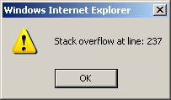
Heuristic Categories
Heuristic Category | Definition
Good Error Messages | Error messages tell users what error occurred and how users can recover from the error. Messages are not abstract or general such as “Forbidden!” Messages should be precise and polite and not blame the user.
“Order cannot be filled” versus
“Order exceeds recommended dosage.”
Notes:
See how the more specific message can guide users to problem solve. Also, error messages should be in context, specific to the situation, be constructive.

Slide 29
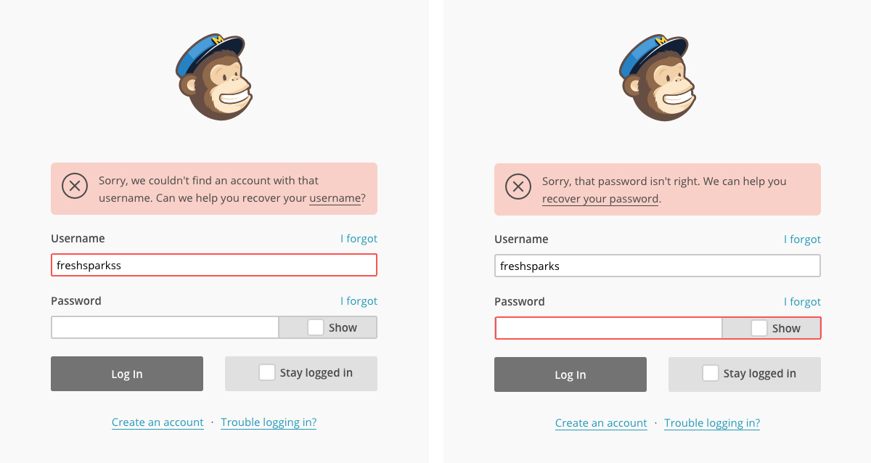
Good error messages
FreshSparks, 2017
Notes:
This is a good example of a good error message because it doesn’t just tell you that the username OR password is incorrect. It tells you exactly which one is incorrect and highlights that box.

Slide 30
Heuristic Categories
Heuristic Category | Definition
Avoid Catastrophic Errors | Product must prevent catastrophic errors as much as possible (e.g., pediatric medication order dosing mixed between kilograms and pounds).
Examples
Missed meds on BCMA (How can you tell?)
Septra order (see the Digital Doctor by Wachter, 2015 or click here)
Notes:
This is a particularly important category for health IT.

Slide 31
Notes:
It’s difficult to obtain the “big picture” (also called situation awareness) of this patient’s medications as they have to scroll back and forth and up and down to see all the medications or to check whether a medication was missed. There is no indicator of a missed med outside the field of view. While a simple fix of a missed med notation is possible, the fundamental issue persists, that the design does not support good medication situation awareness.

Slide 32
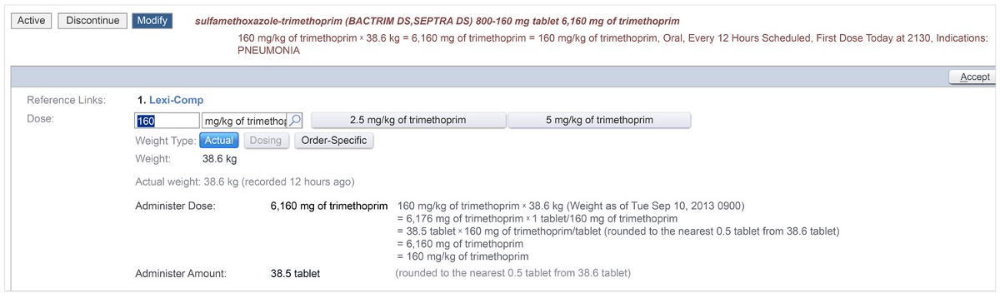
Avoid Catastrophic Errors
Wachter “Digital Doctor”, 2015
Notes:
The Septra order example is explained fully in a book by Wachter (2015). A series of errors exacerbated through the local EHR and human error resulted in a pediatric patient receiving 38.5 tabs of Septra instead of his routine dose of 2 per day (160 mg total).
The patient was taking Septra bid for recurrent skin and lung infections. The Epic default was to order mg/kg but the physician wanted 160 mg total per day. See the middle of the screen for the error. When the physician typed in 160 mg, the default was 160 mg/kg or 38.5 tabs. The institution was a research institution so removed typical alerts and guardrails for doses that exceeded normal limits. Both the pharmacy and nursing thought the dose was high but rationalized it away. The patient received the dose, coded later but was successfully resuscitated.

Slide 33
Heuristic Categories
Heuristic Category | Definition
Clear Closure | Users should know when a task is completed and all information is accepted. Displays should include progress toward 100% completion using a series of bars or other graphical depictions.
Reversible Actions | Whenever possible, actions and interactions should be reversible within legal limits in electronic health records. If actions cannot be reversed, there is a consistent procedure to document the correction of any misinformation in the system.
Clear closure examples
“Your order is placed.”
“If you exit now, your mail will not be sent.”
Reversible actions
Undo (except filed notes or orders)

Slide 34
Heuristic Categories
Heuristic Category | Definition
Use the Users’ Language | The technology uses language and terms the targeted users can comprehend and expect. Health terms are used appropriately.
Use of odd abbreviations, e.g., in BCMA screens, “IEN,” “HSM”
What do these mean?
VA nurses, “We have no idea. We skip over them.”
DNR; right and left eye in an EHR (vs. OD, OS)
Notes:
Staggers, et al, (2015) evaluated BCMA and discovered the abbreviations IEN and HSM. We asked nurses what they meant and they had no idea. The use of these terms violates this heuristic and also minimalist.
It’s important to know what common abbreviations are used by clinicians and other system users. For example, web designers abbreviated
Directory of Nurse Researchers as DNR, but this abbreviation means Do Not Resuscitate to health professionals.

Slide 35
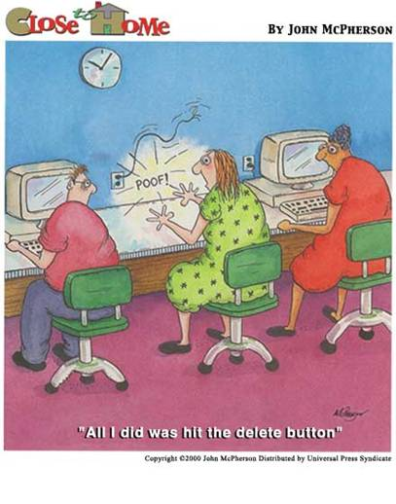
Heuristic Categories
Notes:
Here is another example of use the users’ language that was misinterpreted by the system.

Slide 36
Heuristic Categories
Heuristic Category | Definition
Users in Control | Users initiate actions versus having the perception that the technology is in control. Avoid surprising actions, ending up in unexpected places, and loud sounds when user errors are made.
Help and Documentation | Product provides help for users within the context the actions occur. Embed help functions throughout the application.
Control examples
Principle of least astonishment (sound, surprising actions)
Help within the context of what the user is doing

Slide 37

Need More Explanation and Examples?
Explanation of heuristic categories with examples from the SHARP C project at the University of Texas Health Sciences Center (Houston)
Usability tutorials from this same group
Notes:
For more examples of the 14 categories and additional explanations, please go to this site. UT Houston has a variety of tools and educational material on usability methods.

Slide 38
Consolidated List of Heuristic Categories
Heuristic Category | Definition
Consistency and Standards | Product is consistent across all aspects: methods of navigation; messages and actions; and meaning of buttons, terms, and icons. Advanced evaluation: Product is congruent with known screen design principles for color and screen layout. Product is consistent with International Organization for Standardization (ISO) usability guidelines.
Visibility of System State | Users understand what the system is doing and what they can do with the product from the system messages, information, and displays.
Match Between System and World | The technology matches the way users think and work, uses appropriate information flow, has typical options that users need, and includes expected actions by the system.
Notes:
This is a consolidated list in case learners would like to have it during their own evaluations.

Slide 39
Consolidated List of Heuristic Categories
Heuristic Category | Definition
Minimalist | Product does not display superfluous information. System and screen design are targeted to primary information users’ needs. Use of progressive disclosure to display details of a category of information only when needed. The exception can be designs for expert users where screen density is preferred.
Minimize Memory Load | Product minimizes the amount of information and tasks users must memorize to adequately use the technology. Product makes use of sample formats for data input such as a calendar for date format.
Informative Feedback | The technology provides prompt and useful feedback about users’ interactions and actions (e.g., feedback that orders were placed).
Flexibility and Efficiency | The ability to tailor and customize to suit individuals’ needs. Includes novice and expert capabilities (e.g., string searches).
Notes:
For reference only

Slide 40
Consolidated List of Heuristic Categories
Heuristic Category | Definition
Good Error Messages | Error messages tell users what error occurred and how users can recover from the error. Messages are not abstract or general such as “Forbidden!” Messages should be precise and polite and not blame the user.
Avoid Catastrophic Errors | Product must prevent catastrophic errors as much as possible (e.g., pediatric medication order dosing mixed between kilograms and pounds).
Clear Closure | Users should know when a task is completed and all information is accepted. Displays should include progress toward 100% completion using a series of bars or other graphical depictions.
Reversible Actions | Whenever possible, actions and interactions should be reversible within legal limits in electronic health records. If actions cannot be reversed, there is a consistent procedure to document the correction of any misinformation in the system.
Notes:
For reference only.

Slide 41
Consolidated List of Heuristic Categories
Heuristic Category | Definition
Use the Users’ Language | The technology uses language and terms the targeted users can comprehend and expect. Health terms are used appropriately.
Users in Control | Users initiate actions versus having the perception that the technology is in control. Avoid surprising actions, ending up in unexpected places, and loud sounds when users make errors.
Help and Documentation | Product provides help for users within the context the actions occur. Embed help functions throughout the application.
Notes:
For reference

Slide 42
Apply CDS Impact Evaluation Framework Steps to Heuristic Evaluation

Slide 43
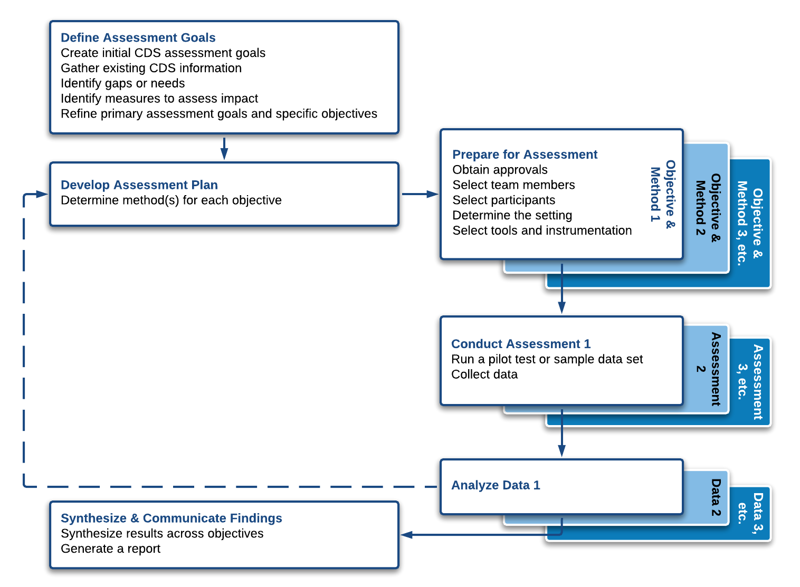
CDS Impact Evaluation Framework
1
3
2
4
5
6
Notes:
Learners are reminded of the 6 steps in the CDS Impact Evaluation Framework shown here: Define Assessment Goals, Develop Assessment Plan, Prepare for Assessment, Conduct Assessment, Analyze Data and Synthesize and Communicate Findings.

Slide 44
CDS Impact Evaluation Framework
1
3
2
4
5
6
Notes:
Let’s apply the Framework to Heuristic Evaluation starting with step 1, Define Assessment Goals.

Slide 45
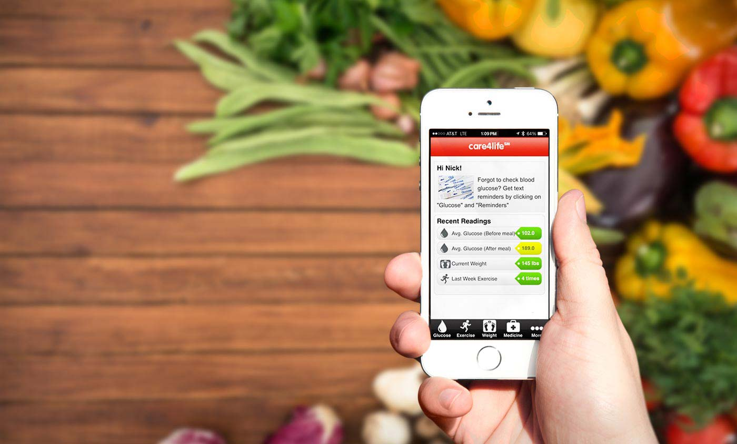
Define Assessment Goals & Create Specific Objectives
Major goals are previously defined so evaluators know they are using heuristic evaluation as a method
Next step is to refine specific objectives
Objectives for heuristic evaluation can be more general, for example:
What are the usability problems with this CDS intervention?
What are their severity levels?

Slide 46
CDS Impact Evaluation Framework
1
3
2
4
5
6
Notes:
We’ve already chosen heuristic evaluation, so we will skip step 2 and go to step 3: Prepare for Assessment.

Slide 47
Prepare for Assessment
Preparing for the assessment is the most time-consuming part of a heuristic evaluation
Obtain approvals
Select team members
Select participants
Determine the setting and create software CDS testing environment
Select tools and instrumentation
Create tasks
Prepare briefing instructions
Develop training materials
Develop test materials packet
Notes:
Here are the typical elements for Prepare for Assessment.

Slide 48

Prepare for Assessment
Obtain Approvals
IRB approvals are not usually required for heuristic evaluations
Managerial approvals may be required in order to obtain funding or allocate time to work on the assessment
Evaluators are referred to VA guidance about QI efforts vs. research
VHA Handbook 1058.05, VHA Operations Activities That May Constitute Research

Slide 49

Prepare for Assessment
Select Team Members
Lead evaluator:
Guides the entire process
Has formal knowledge, training, and expertise in conducting heuristic evaluations
Evaluators:
Partner with the lead evaluator on the heuristic evaluation
Can have various backgrounds (leads to a more comprehensive evaluation)
3–5 single-domain experts or 2–3 dual-domain experts (domain plus usability)
Notes:
Three to five single-domain experts will find between 74%– 87% or usability problems, while two to three dual-domain experts find between 81%– 90% of usability problems (Nielsen, 1992).
Considerations for selecting evaluators include:
Clinical expertise;
Expertise related to the CDS intervention;
Informatics knowledge;
Usability expertise;
Research expertise;
Experience in using heuristic evaluation in the past; or
A combination of the above.

Slide 50

Prepare for Assessment
Select Participants
No participants are needed for the main assessment
Recall that it’s an expert method
Evaluators may consult participants or clinical experts to verify findings and/or implications of the findings
Notes:
Since this is an expert assessment, participants are not needed. After the experts complete their evaluations, they may find consultation with users helpful to verify and validate findings.

Slide 51
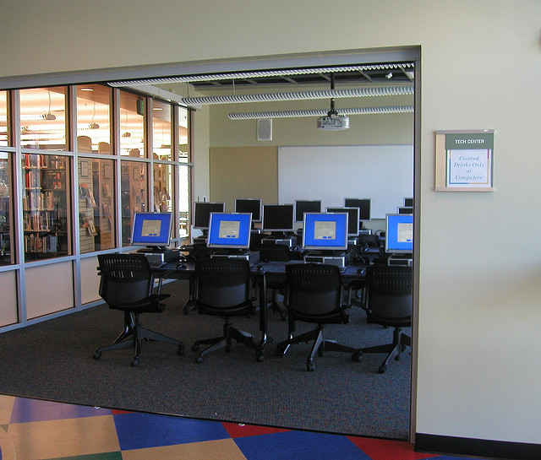
Prepare for Assessment
Determine the Setting and Create the Software CDS Test Environment
Quiet workspace for evaluators to complete the evaluation or
Virtual access
With access to the application or to the training environment
May need to work with the IT department to create a test environment
Notes:
Evaluators may need to work with the IT department to set up a computerized testing environment for evaluators so they don't inadvertently compromise real patient data during their assessment. Or they may obtain access to the training environment.
The environment must allow refresh of the application as new evaluators begin their assessment.

Slide 52
Prepare for Assessment
Select Tools and Instrumentation
Create Tasks
Prepare Briefing Instructions
Defined tasks within a specific context
Tasks must be specific and discrete
Lead evaluator uses a script to guide other evaluators through the processes planned
Can be verbal or electronic
Notes:
Create tasks
Example of specific and discrete task would be “navigate to the vital signs section of the SMARTForm,” not “navigate around the interface.”

Slide 53
Prepare for Assessment
Sample tasks for electronic medication administration records (eMAR)
Order and modify medication(s)
Verify medication orders
Prepare medication
Access medication information/help
Administer and chart medication(s)
Generate reports and review eMAR
Staggers, Iribarren, Guo, & Weir, 2015
Notes:
This is to illustrate the types of tasks that might be defined for interacting with an eMAR. See how distinct they are and how they can guide an evaluator during a heuristic evaluation.

Slide 54
Prepare for Assessment
Sample Briefing Instructions
Thank you for participating in this assessment. As a reminder, we are conducting a heuristic evaluation of [name the CDS intervention]. You can access the CDS intervention at [provide the location or URL]. Training on this CDS intervention is available at [provide the location or online training location]. After training, you will complete your assessments individually using the list of heuristics provided to you. Please use the list of tasks [provide the list] to interact with the CDS intervention and outline any usability problems on the form provided [provide the form]. The assessment period is over the next [name the dates]. You may upload your findings at [provide the URL] or communicate directly with [give the contact person]. Questions are welcome at any time. After our individual assessments, we will compile the findings into a master list and complete further analyses.
Notes:
This is a template for reference. Templates for briefing instructions are available in the Assessment Protocol for this method and the other usability methods we discussed as part of this training.

Slide 55
Prepare for Assessment
Select Tools and Instrumentation
Develop Training Materials
Develop Test Materials Packet
Use standardized training
Develop a demographic questionnaire
Ensure that evaluators have the same baseline knowledge and skills concerning the intervention and heuristic evaluations
Create heuristic categories
Assign severity ratings
Collect screenshots
Notes:
Develop training materials:
When evaluators are given the same information during training, it increases the likelihood that major usability problems will be discovered and it reduces variability among evaluators’ findings to avoid lack of depth in interactions among evaluators. Training is important for anyone who is not a regular user of the product, and it is critical for evaluators who are unfamiliar with the product. Beyond that, evaluators bring in their own knowledge and skills to the evaluation.
As needed, the lead evaluator can conduct the training sessions on the intervention or heuristic evaluation or standardized institutional training may be available.

Slide 56
Prepare for Assessment
Sample Data Collection Forms
Demographic forms with these fields at minimum
Profession
Education level
Specialty
Usability experience
Assign heuristic categories, severity ratings
The 14 categories from Zhang et al (2003)
Review definitions and sample usability problems
Clarify with the team prn
Notes:
The demographic form will include any information that may impact how the evaluator will use/interpret the intervention. This can include their specific experience in health, education level, etc.

Slide 57
Prepare for Assessment
Heuristic Category | Sample Items to Evaluate
Consistency and Standards | Screens have consistent layout (e.g., patient name is in the same location on each screen; navigation for back, exit, help, or home is in the same location) Icons are intuitive, make sense to clinicians
Visibility of System State | Items should change appearance when selected and at each step in a list or process (helpful when a user is interrupted) Corrections, deletions, modifications, copy/pastes should be visible and change appearance
Match Between System and World | Information flow matches users’ thought processes Key information is prominent for linked or “chunked” information such as a bed number on a patient roster Critical information is available when needed (e.g., not buried in an electronic “sticky note” or awaiting a system refresh) Complete information is available for the task (e.g., auto population works)
Notes:
These slides show heuristic category examples that overlap both the prepare and conduct the assessment. They provide guidance to the team to make sure the team understands definitions and items for evaluation under each heuristic category.

Slide 58
Prepare for Assessment
Heuristic Category | Sample Items to Evaluate
Minimalist | Information is tailored to the user’s specialty (e.g., surgeons do not see full preventive medication alerts) Use of graphs and images versus text to show patterns with discrete data available as needed
Minimize Memory Load | Minimal clicks especially for common tasks
Informative Feedback | Clear messages after actions (e.g., “assessment saved,” “order entered,” or “order still pending”)
Flexibility and Efficiency | Availability to tailor to specialty and expertise (e.g., primary care vs. anesthesiology notes)
Good Error Messages | Clear error messages (e.g., “need reason for alert override” or “mandatory field left blank,” with a pointer to which one)

Slide 59
Prepare for Assessment
Heuristic Category | Sample Items to Evaluate
Avoid Catastrophic Errors | Alerts for out-of-range values for a field (e.g., temp of 400°)
Clear Closure | Clear indicator when process is completed (e.g., with a message, change in appearance, or the like)
Reversible Actions | Availability of an undo button wherever appropriate
Use the Users’ Language | Terms and abbreviations make sense to users
Users in Control | No unexpected system actions (e.g., maintenance cycle during shift change or prime medication times)
Help and Documentation | Help is context-sensitive (e.g., tailored to the location in the application versus having to search the entire help document)

Slide 60
Prepare for Assessment
Use a Table to Record Sample Usability Problems
Task | Description of Usability Problem
Administer Medications | BCMA screen does not have an indicator for automatic refresh; nurses must continually click refresh (a multiple-step process) or exit out and reenter to avoid missing new or discontinued orders. No structured option is available to document medication patch placement location; nurses must use a free-text field.
Prepare Medications | No easy way to organize/prepare for medication administration, especially across patients; work-around is to run missed medication reports often. Nurses must document IVs using “IV bag chronology,” which is not intuitive.
Other tasks | Describe identified usability problems.
Staggers, et al., 2015

Slide 61
Prepare for assessment
Problem Step Recorder (Microsoft product)
PSR captures each screen shot upon click or keystroke and stores them for viewing
Excellent resource for screen captures, illustrating usability problems
Better for simpler tasks due to screen capture limits
Find tips on how to use PSR (also called step recorder)
Screen capture limit = 100 with Windows 7
Screen capture limit = 1000 with Windows 10
Notes:
This is a tool embedded in Windows that evaluators may find helpful as they conduct an evaluation. At minimum, it provides a method for screen capture to illustrate important or catastrophic usability problems.

Slide 62
CDS Impact Evaluation Framework
1
3
2
4
5
6
Notes:
Next we move to step 4: Conduct Assessment

Slide 63
Conduct Assessment
Lead evaluator uses training materials and test materials packet to introduce evaluation and intervention to evaluators
Evaluators work with lead evaluator to schedule time for the evaluation
Evaluators will individually step through the CDS intervention and record all usability problems
Previously developed heuristic categories can be used as a guide for the evaluators to identify all usability problems
Evaluators will deliver their findings in the format decided by the lead evaluator
Lead evaluator collects all information from evaluators
Notes:
Heuristic evaluation involves a number of steps:
Evaluators will use previously developed validated tasks to step through the intervention individually first.
They will record any usability problems they encounter on the previously developed data collection form.
Evaluators can use the heuristic categories as a guide to identify problems, including major and minor usability problems.
Data collection forms may be virtual or hand-written. They often include screenshots.
Data can be submitted in person, online, through email, etc.
The lead evaluator compiles and consolidates the list of usability problems.

Slide 64
Conduct Assessment
Sample Table for Data Collection
Task | Description of Usability Problem | Location
Administer Medications | BCMA screen does not have an indicator for automatic refresh; nurses must continually click refresh (a multiple-step process) or exit out and reenter to avoid missing new or discontinued orders. No structured option is available to document medication patch placement location; nurses must use a free-text field. | A list outlining where the problem exists and/or screenshots. For example, in this case, the usability issue is located on the BCMA screen, one of four possible screens in the eMAR.
Prepare Medications | No easy way to organize/prepare for medication administration, especially across patients; work-around is to run missed medication reports often. Nurses must document IVs using “IV bag chronology,” which is not intuitive.
Other tasks | Describe more identified usability problems.
Notes:
This is one example of a table to document usability problems with associated screenshots for initial data collection.

Slide 65
CDS Impact Evaluation Framework
1
3
2
4
5
6

Slide 66
Analyze Data
Four Steps
Consolidate usability problems into a master list (lead evaluator)
Assign problems to heuristic categories (individually)
Assign severity ratings (individually)
Average severity ratings (lead evaluator)
Notes:
Lead evaluator consolidates problems into master list but evaluators may need to clarify description of problems before analyses occur
Convene the evaluators as a group to discuss and clarify
Lead evaluator will total how frequently problems occurred across evaluators
Once a problem is placed into a heuristic category, it is known as a heuristic violation
Can be completed by the lead evaluator or in a group
A problem may also be placed into more than one heuristic category
Evaluators assign severity ratings so an average severity rating is calculated for each problem that occurs for more than one evaluator
Expanded data collection form will include task, description, heuristic violations, severity, and frequency

Slide 67
Analyze Data
Definitions of Severity Ratings
Severity Rating | Description | Priority
0 | Not a usability problem. | None
1 | Cosmetic—No need to fix unless extra time is available. | Low
2 | Minor—Annoying issue with minor impact. | Medium
3 | Major—Important to fix. Issues with major impact in use or during training or both. Consider the numbers and kinds of users affected. | High
4 | Catastrophic—Severe issue that must be corrected, especially issues related to patient safety. Imperative to fix this before product can be released (if in development). | Critical
Nielsen & Mack, 1993

Slide 68
Analyze data
Sample Data Collection Tool
User Goal or Task:
# | Description of the Problem | Heuristics Violated | Severity Rating | Screenshots
1
2
3
4
Includes category descriptions, scenarios, access to a test patient, etc.
Notes:
This tool is from the VA’s 10x10 program (provided by Scott Wood, PhD) and shows findings across analysis steps.

Slide 69
Module Review

